Slide 1
Player Report Automation
In Progress
Player Report Automation
Automated
Scalable
Data-Driven
Real-time
June - August 2025
Team: Dasol Shin, Christian Bolton
Data Analytics | Group 2

Slide 2
Project Overview & Objectives
Core Objectives
Project Introduction
This high-priority project aims to create an automated,
scalable reporting system for player tracking using Looker Studio as the frontend visualization tool.
Automate Data Collection
Create automated workflows for data gathering and
processing
Build Scalable Architecture
Design a system that can grow with the organization
Key Challenges
Data dispersion across multiple systems
Time-consuming manual reporting processes
Limited real-time analysis capabilities
Project Leads:
Dasol Shin & Christian Bolton
Integrate Multiple Data Sources
Consolidate data from various testing scenarios
Create Interactive Dashboards
Build dynamic visualizations using Looker Studio
Expected Impact: Increase data analysis efficiency, improve decision-making, and reduce reporting time from hours to minutes.
2/11

Slide 3
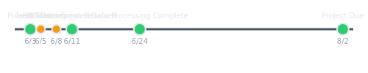
Project Timeline & Team
Project Timeline
Team Composition
Dasol Shin
Owner
Primary responsible for database setup and data processing
Responsible for data analysis and Looker Studio implementation
DB Code
Start Date
June 4, 2025
Due Date
August 3, 2025
Christian Bolton
Owner
Responsible for data analysis and Looker Studio implementation
Analytics ReportinComm
Duration
61 days
Priority
High
Current Status: In Progress (66% complete)
Automated Player Tracking & Reporting System via Looker Studio
3/11

Slide 4




Current Progress & Milestones
Initial Planning
Technical Challenges
Data Processing
Project kickoff meeting (June 6)
Database connection issues (June 9-10)
Setup SQL Workbench database environment
Imported test data from three tables
Matched training data for velocity analysis Created and uploaded summary table
Defined initial project scope
Team meeting to address database problems (June 11)
Created system operation manual
Designed human-computer interaction prototype
Meeting with Noah to discuss MySQL issues (June 12)
Resolved IP address permissions issue (June 13)
Current Status
As of JULY 31ST, the project has completed the data processing phase, with all three test scenarios (pull_down, bull_pen, and
plyo_testing) integrated into a unified summary table. The team is now prepared to implement the final data pipeline to Looker Studio and begin dashboard development.
Automated Player Tracking & Reporting System via Looker Studio
4/11

Slide 5
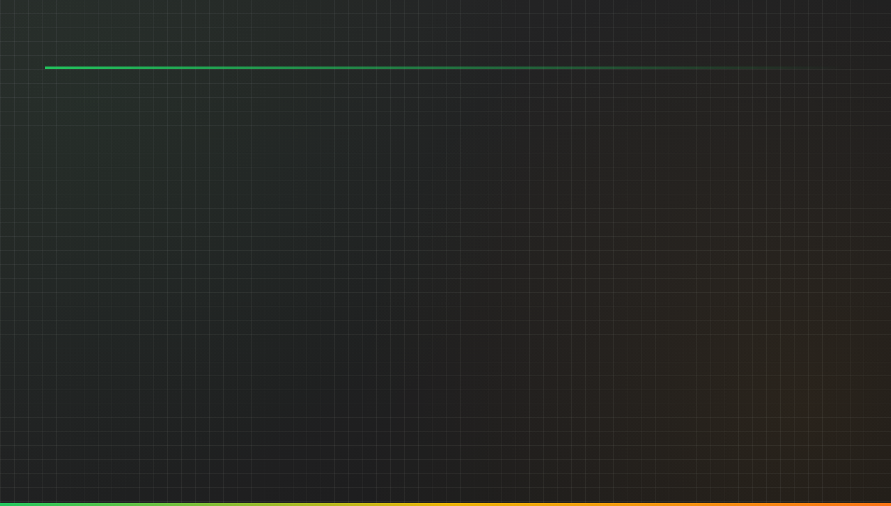
Data Processing Strategy
Data Sources Processing Flow
Results & Methodology
Pull Down Testing
player_velocity_summary Structure
Column Data Type
player_id VARCHAR
pull_down_velocity FLOAT
bull_pen_velocity FLOAT
plyo_velocity FLOAT
Data Import
SQL Workbench
Assists with measuring speed during pull-down exercises
Data Matching
Pull-down & Bull pen& Plyo ball
Bull Pen Testing
Evaluates performance and velocity
Velocity Computation
Average calculation
Plyo Testing
Tests explosive movement and velocity
Key Methodology Notes
player_velocity_summary
Central summary table
Matched pull-down and bull pen sessions for direct velocity comparison
Computed average plyo velocity per player due to inconsistent testing dates
Merged all velocity data into a unified summary table
Uploaded processed data to the central database
6/11

Slide 6
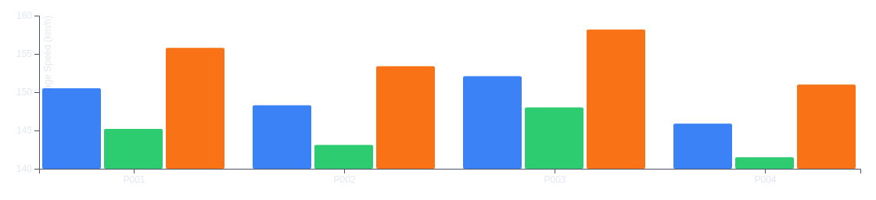
Preliminary Results & Visualizations
Velocity Comparison by Test Type
Pull-down
Bull-pen
Plyo
Initial Data Findings
Data successfully aggregated from three test scenarios into unified table
Average speed calculations verified data usability
Plyo testing shows consistently higher speeds across all players
Visualization Insights
Python-generated grouped bar charts validated data structure and provided insights for Looker Studio dashboard design.
Next: Implement in Looker Studio with interactive filtering
Automated Player Tracking & Reporting System via Looker Studio
7/11

Slide 7
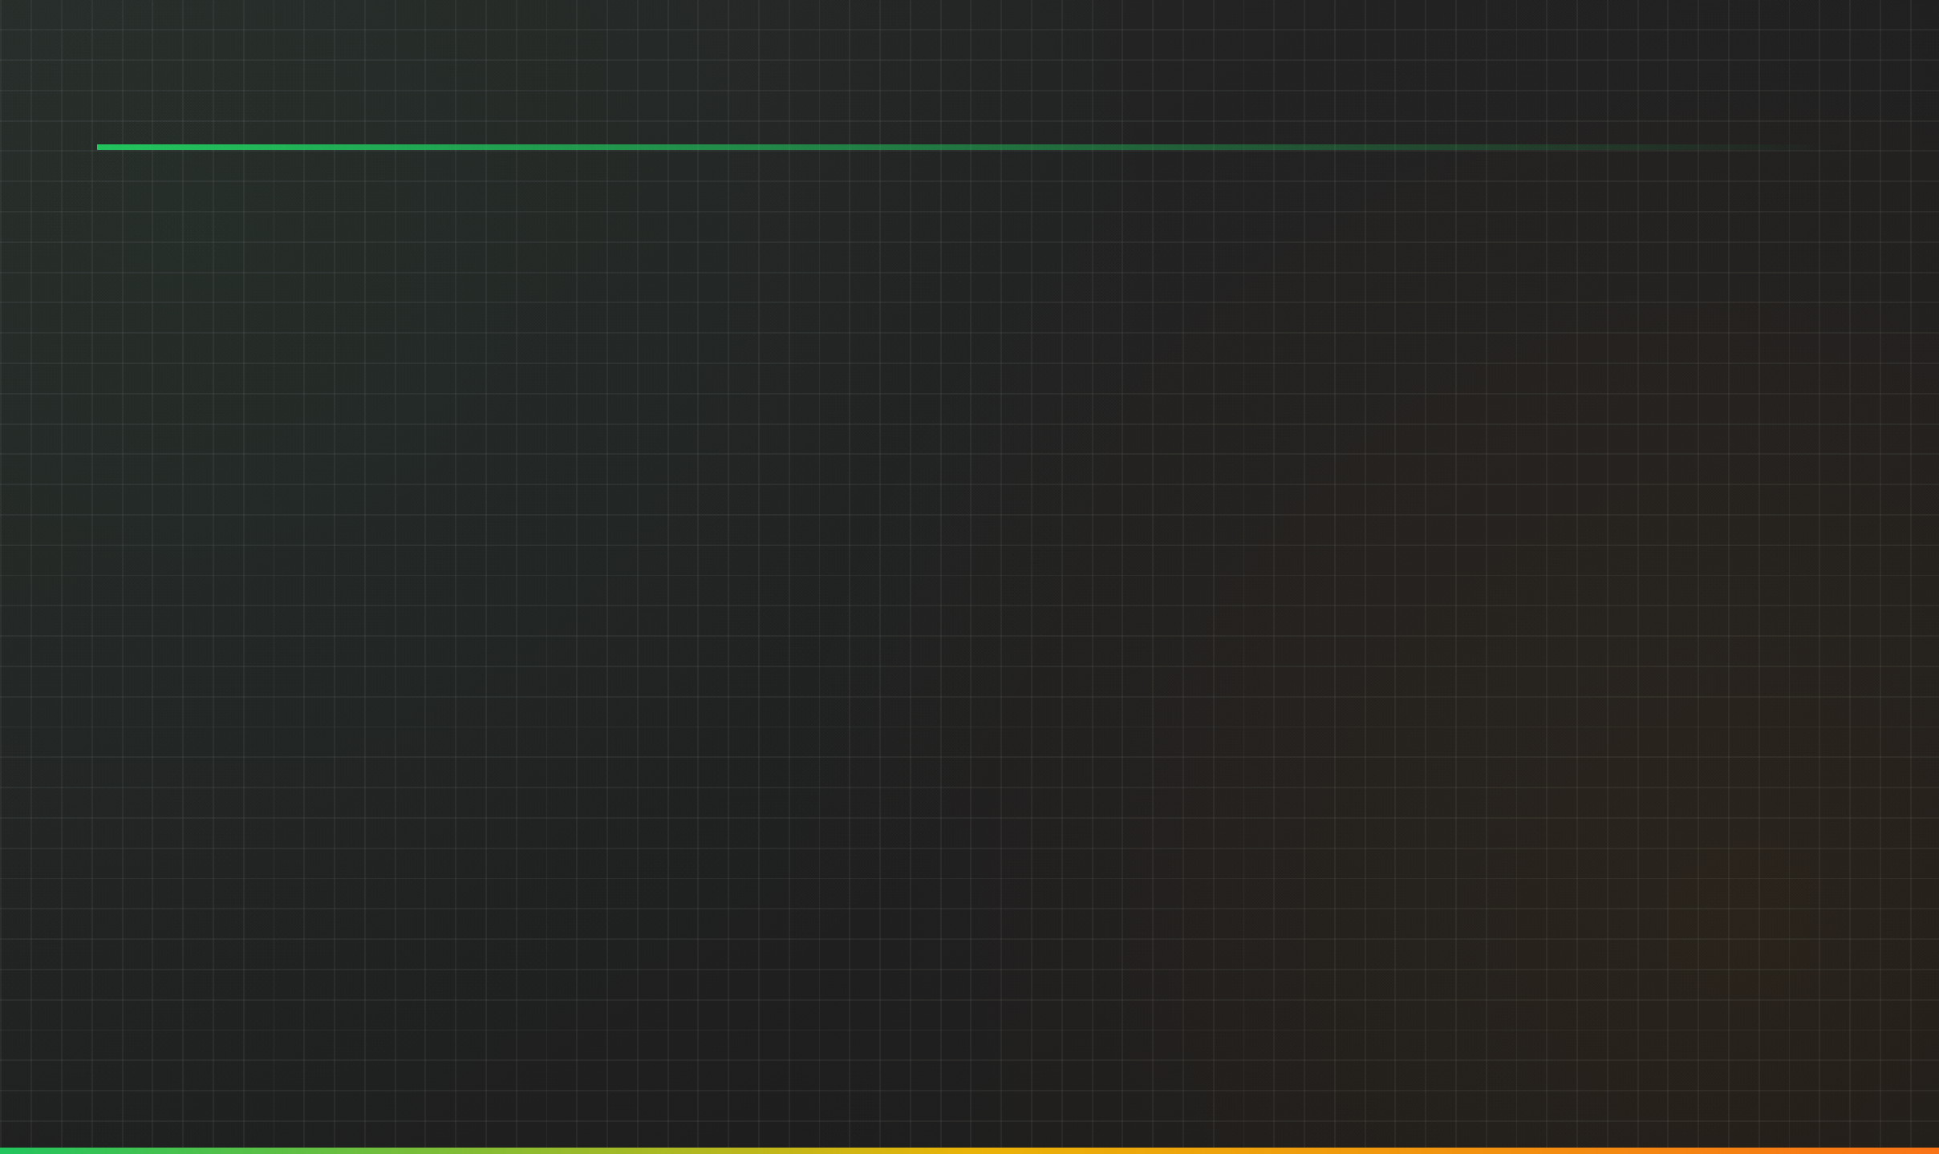
Automation Workflow
Data Source Integration
Connect to SQL Workbench and import data from testing tables
Data Processing
Match and average data across different testing scenarios
Dashboard Creation
Create views and dashboards for data visualization
Automated Refresh
Implement automatic data refresh mechanisms
Implementation Details
Key Workflow Components
Created views for different testing scenarios Cloned dashboard templates for consistency Automated data refresh processes
Design Reference
Used a flowchart template designed for Google Analytics (GA4) as a blueprint for the automation workflow.
Custom_Expert_Commentary_Demo_with_Google_Analytics_(GA4)
Served as a reference template for workflow design
9/11
Automated Player Tracking & Reporting System via Looker Studio

Slide 8
Next Steps & Recommendations
1 2 3 4
Finalize Database Work
Further familiarize team with MySQL and perform final data cleaning and validation before connecting to Looker Studio
Implement Data Pipeline
Establish stable data connection from the
player_velocity_summary table to Looker Studio
Dashboard Development
Build interactive and scalable athlete tracking dashboards in Looker Studio based on the unified data set
Documentation
Complete the system operation manual and deliver a functional prototype for end-user testing
June 25
July 5
July 15
July 25
Key Recommendations
Prioritize data quality - Ensure data cleanliness and validation before connecting to Looker Studio
Test automation - Thoroughly test the automated refresh mechanisms to ensure real-time data availability
Automated Player Tracking & Reporting System via Looker Studio
10/11

